Slide 1



Examination System Comprehensive Database, Stored Procedures & Reporting Solution
Islam Mohamed
Esraa Morsy
Ahmed Negm
Omar Nafea
Abdallah Hamdy
8/9/2024
Information Technology Institute (ITI)

Slide 2
Project Overview
This project focuses on automating an examination system, allowing online exams, automated grading, and comprehensive reporting through SQL-based databases and dashboards.
ERD Design: Developed a detailed Entity-Relationship Diagram (ERD) to visualize the system’s architecture.
Mapping: Translated the ERD into a comprehensive database schema, ensuring logical mapping between entities and their relationships.
Database Creation: Created a SQL database consisting of 21 tables. These include key entities such as Students, Courses, Instructors, Certificates, Freelancing Jobs, exams, Tracks, and Branches, structured to manage exam data, grading, and more.
Stored Procedures: Implemented 70+ stored procedures for a variety of operations, including CRUD functions, exam generation, answer collection, grading, and more.
Reports: Developed detailed reports using Report Builder. These reports include student performance, instructor course lists, course topics, and exam details.
Dashboards: Designed Power BI dashboards to visualize various aspects of the system.

Slide 3
Entity-Relationship Diagram Overview
Key Entities:
USRS: Represents users with personal details and credentials.
INSTRUCTORS: Contains information about instructors, including their qualifications and salary.
STUDENTS: Holds data about students.
COURSES: Lists courses, linked to topics and instructors.
EXAMS: Contains details about exams, including the associated courses and questions.
CERTIFICATES: Represents certificates awarded to students.
FREELANCING_JOBS: Details freelancing jobs associated with students.
TRACKS, BRANCHES, TOPICS: Represent various tracks, branches, and topics.
Key Relationships:
USRS to INSTRUCTORS: Instructors are users with additional attributes.
USRS to Students: Students are users with additional attributes.
INSTRUCTORS to COURSES: Instructors teach courses.
COURSES to TOPICS: Courses are categorized under specific topics.
STUDENTS to COURSES: Students enroll in courses.
EXAMS to COURSES: Exams are associated with specific courses.
STUDENT_ANSWERS to EXAMS and QUESTIONS: Stores answers given by students in exams.
Tracks to Courses: Tracks include specific courses.

Slide 4
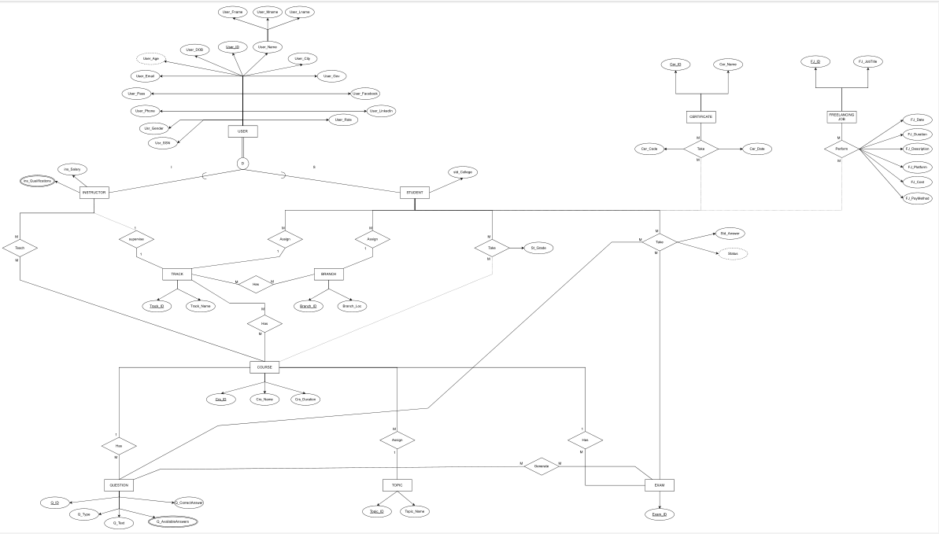
Entity-Relationship Diagram

Slide 5
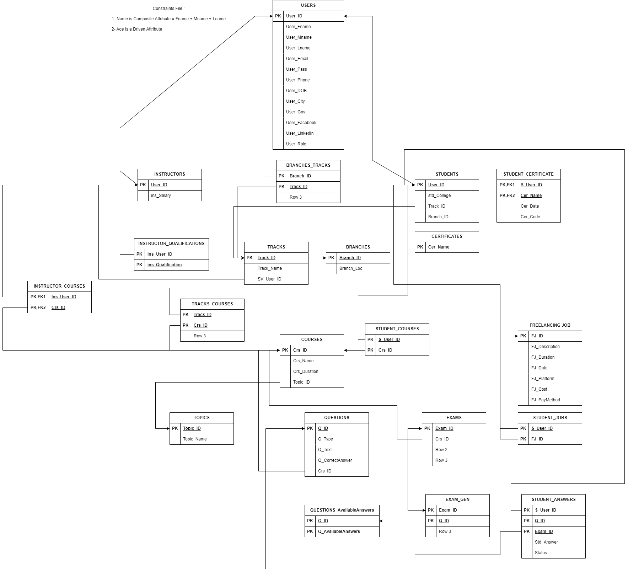
Mapping

Slide 6
Database Structure and Design Overview
USRS Table stores information about all system users, including instructors and students. This table includes fields for the user's first name, middle name, last name, email, hashed password, phone number, date of birth, and social security number. I applied several constraints to ensure data integrity, such as checking for valid email domains, ensuring the phone number format matches common patterns, and confirming that social security numbers contain only digits.
INSTRUCTORS Table stores salary details for each instructor. This table is linked to the USRS table via a foreign key and includes a constraint to ensure that the instructor's salary is always a positive number.
INSTRUCTOR_QUALIFICATIONS Table The INSTRUCTOR_QUALIFICATIONS table stores the qualifications of instructors. This table includes a foreign key relationship with the INSTRUCTORS table, ensuring that qualifications are tied to specific instructors.
TOPICS Table The TOPICS table contains a list of topics that courses may cover. Each topic has a unique identifier and name.

Slide 7
Database Structure and Design Overview
COURSES Table stores the course names and durations. Each course is associated with a topic from the TOPICS table, and I included a constraint to ensure that course durations are positive.
INSTRUCTOR_COURSES Table The INSTRUCTOR_COURSES table links instructors with the courses they teach. It includes foreign key relationships with both the INSTRUCTORS and COURSES tables, ensuring that only valid instructors can be assigned to courses.
TRACKS and TRACKS_COURSES Tables The TRACKS table stores information about educational tracks, which group related courses. The TRACKS_COURSES table then links tracks to specific courses, ensuring that each track contains valid courses.
BRANCHES and BRANCHES_TRACKS Tables The BRANCHES table stores locations for educational branches, while the BRANCHES_TRACKS table links branches with their available tracks.
QUESTIONS and QUESTIONS_AvailableAnswers Tables The QUESTIONS table stores the questions used in exams, with a constraint on question types (multiple choice or true/false). The QUESTIONS_AvailableAnswers table stores the possible answers for each question, linked via foreign keys.

Slide 8
Database Structure and Design Overview
EXAMS and EXAM_GEN Tables The EXAMS table stores information about exams, while the EXAM_GEN table generates exams by linking specific questions to each exam.
STUDENTS Table The STUDENTS table stores details about students, including their college, track, and branch. It is linked to the USRS table via a foreign key.
STUDENT_COURSES Table The STUDENT_COURSES table tracks which courses each student is enrolled in. This table is linked to both the STUDENTS and COURSES tables.
STUDENT_ANSWERS Table The STUDENT_ANSWERS table stores the answers students submit for exam questions, along with a status indicating whether the answer is correct. I added triggers to automatically update the status based on the correct answer.
CERTIFICATES and STUDENT_CERTIFICATES Tables The CERTIFICATES table stores information about available certifications, while the STUDENT_CERTIFICATES table tracks the certificates awarded to each student.
FREELANCING_JOBS and STUDENT_JOBS Tables Lastly, the FREELANCING_JOBS table stores freelancing job opportunities, and the STUDENT_JOBS table tracks the jobs completed by students, including job details like duration, platform, and payment method. Constraints are applied to ensure valid platforms and payment methods.

Slide 9
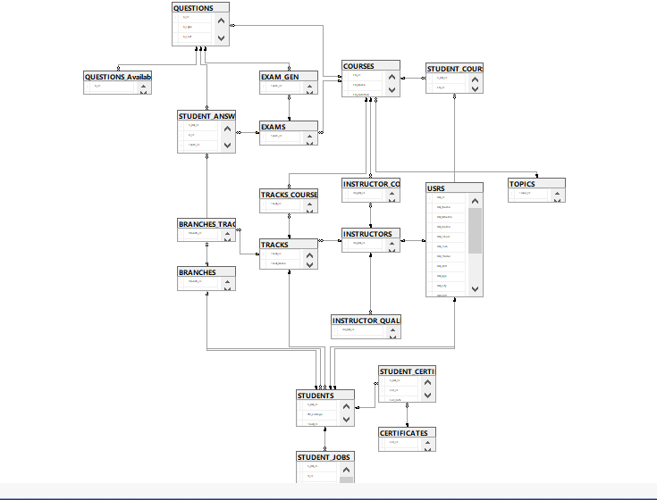
Database Structure and Design Overview

Slide 10
Stored Procedures
In our examination system, stored procedures play a crucial role in managing various functionalities. Here’s a brief overview of the stored procedures implemented:
Retrieving Data
Stored procedures for selecting data allow us to query the database based on specific criteria. This is essential for generating reports and retrieving information needed for decision-making.
Adding New Records
Insert procedures handle the addition of new records to the database. This is crucial for adding new users, courses, or other entities.
Modifying Existing Records
Update procedures are used to modify existing records. This is useful for making changes to user profiles, course details, and other records.
Removing Records
Delete procedures handle the removal of records from the database. This ensures that outdated or irrelevant data is efficiently managed.

Slide 11
Stored Procedures
Stored Procedures for Exam Management
Procedure Name: ExamGeneration
Generates a new exam based on the course name.
Selects a specified number of MCQ and T/F questions randomly from the question pool.
Uses transactions to ensure data integrity.
Randomly selects questions to avoid bias.
EXEC ExamGeneration
@Crs_Name = 'Data Warehousing for Business Intelligence',
@Num_MCQs = 10,
@Num_TF = 5;

Slide 12
Stored Procedures
Stored Procedures for Exam Management
Procedure Name: InsertStudentAnswer
InsertStudentAnswer stored procedure is designed to record student responses to exam questions.
This procedure allows the insertion of a student’s answer into the ‘STUDENT_ANSWERS’ table, which is essential for tracking individual responses and evaluating exam performance.
exec InsertStudentAnswer
@S_Usr_ID =297,
@Q_ID =184,
@Exam_ID =25,
@Std_Answer ='True'

Slide 13
Stored Procedures
Stored Procedures for Exam Management
Procedure Name: GetStudentExamResults
Calculates the student's score based on their answers and updates their grade in the STUDENT_COURSES table.
Process Flow:
Retrieve Data: The procedure starts by retrieving the number of correct and incorrect answers for the student.
Calculate Score: It calculates the percentage score, taking care to handle cases where there are no questions (to avoid division by zero).
Update Grades: The score is then updated in the table, reflecting the STUDENT_COURSES student’s performance in the relevant course.
exec GetStudentExamResults
@S_Usr_ID = 297,
@Exam_ID = 25

Slide 14
Stored Procedures
stored procedures to generate various reports
Procedure Name: GetStudentsByBranchLocations
This stored procedure retrieves student information based on specified branch locations. It allows for flexible querying by using a comma-separated list of branch locations to identify the relevant students.
EXEC GetStudentsByBranchLocations @Branch_LOCs = ‘Cairo’
Procedure Name: StudentGradeInAllCourses
this procedure provides a comprehensive view of a student’s grades across all enrolled courses.
EXEC StudentGradeInAllCourses @st_id = 1;
Procedure Name: InstructorCoursesAndNumOfStudents This procedure lists the courses taught by a specific instructor along with the number of students enrolled in each course.
EXEC InstructorCoursesAndNumOfStudents @ins_id = 10;

Slide 15
Stored Procedures
stored procedures to generate various reports
Procedure Name: TopicByCourse
Retrieves the topics covered in a specific course, providing insights into the course content.
EXEC TopicByCourse @crs_id = 98;
Procedure Name: ExamQuestions_Choices
Generates a report on the questions and available choices for a specified exam.
EXEC ExamQuestions_Choices @exam_id = 101;
Procedure Name: ExamQuestion_StudentAnswer
Provides a detailed report of the questions in an exam along with the student’s answers.
EXEC ExamQuestion_StudentAnswer @exam_id = 101, @st_id = 123;

Slide 16
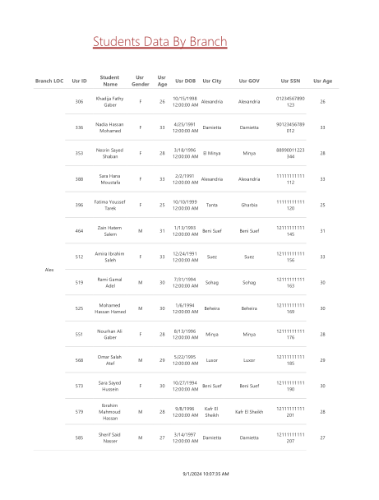
Reports Overview
these reports are designed to help ITI staff view specific data insights from the database.
Student Information by Branch: Returns student information based on Branch Number.

Slide 17
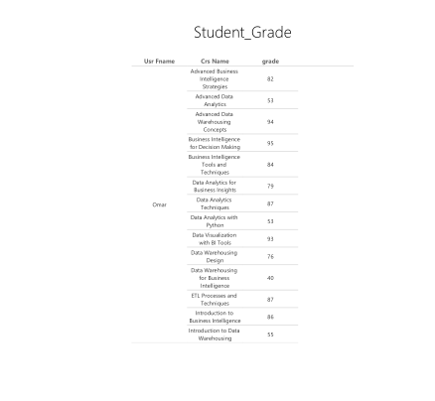
Reports Overview
Student Grades by ID: Displays grades of a student across all courses based on Student ID.

Slide 18
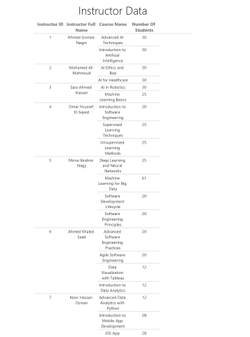
Reports Overview
Instructor Courses and Enrollment: Shows the courses taught by an instructor and the number of students per course.

Slide 19
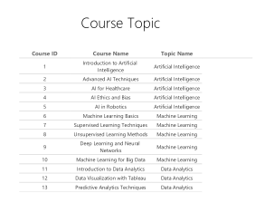
Reports Overview
Course Topics: Lists topics covered in a specific course based on Course ID.

Slide 20
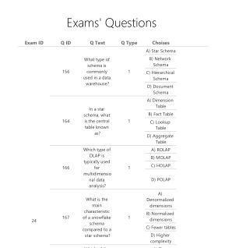
Reports Overview
Exam Questions and Choices: Displays questions and their choices for a specific exam.

Slide 21
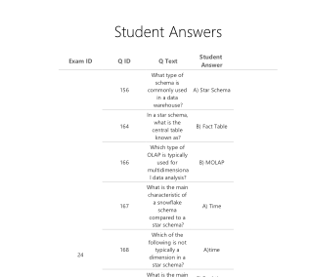
Reports Overview
Exam Questions and Student Answers: Shows exam questions along with the answers provided by a specific student.

Slide 22
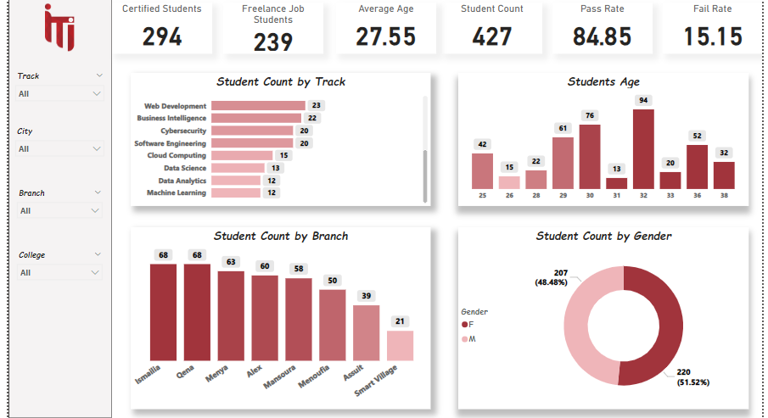
DASHBOARDS OVERVIEW
Students Dashboard : It shows the details about the students and can be filtered using more than one filter

Slide 23
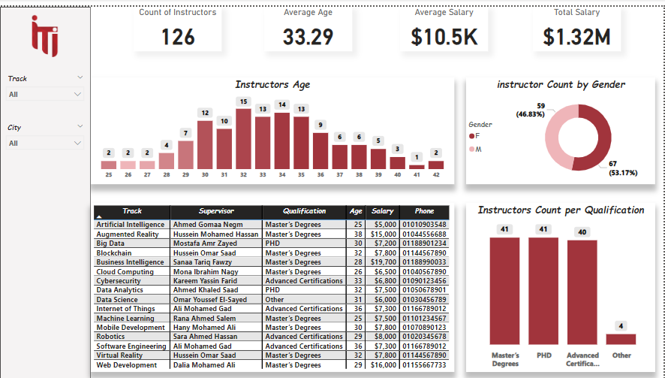
DASHBOARDS OVERVIEW
Instructors Dashboard : : It shows the details about the Instructors and can be filtered using city and track .

Slide 24
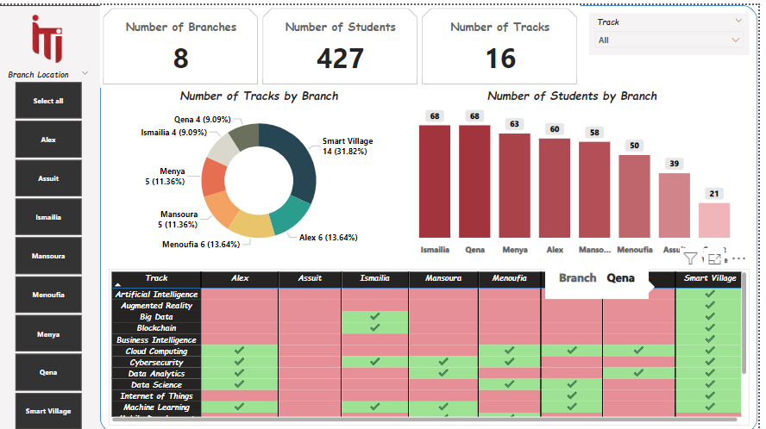
DASHBOARDS OVERVIEW
Branches Dashboard : Shows the number of students and tracks in each branch and the available tracks .

Slide 25
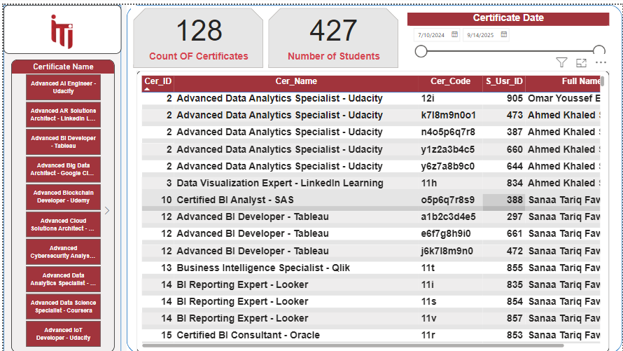
DASHBOARDS OVERVIEW
Certificates Dashboard : Certificates Dashboard : shows details about the Certificates and the students who gett it .

Slide 26
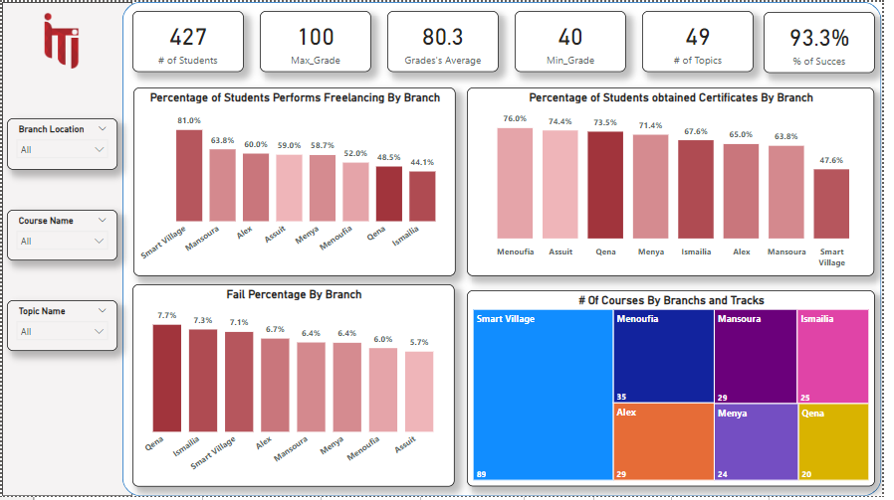
DASHBOARDS OVERVIEW
Overall performance Dashboard :Shows Percentage of Students Performs Freelancing and obtained Certificates & Fail Percentage .

Slide 27
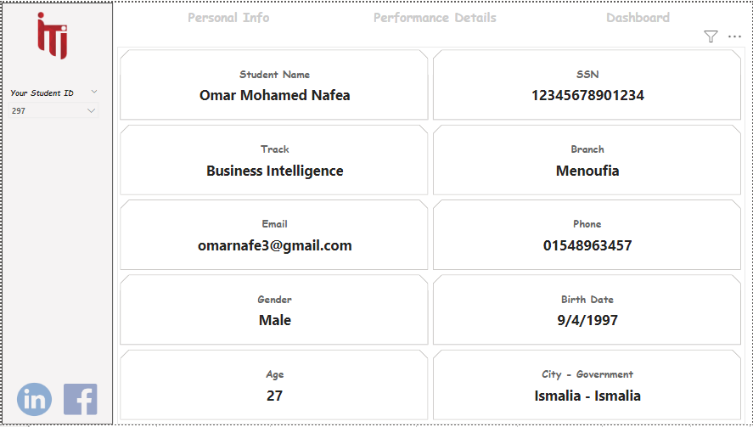
DASHBOARDS OVERVIEW
Student Dashboard (Personal Info): we can select id of student to shows all information about it and his profiles by using some buttons .

Slide 28
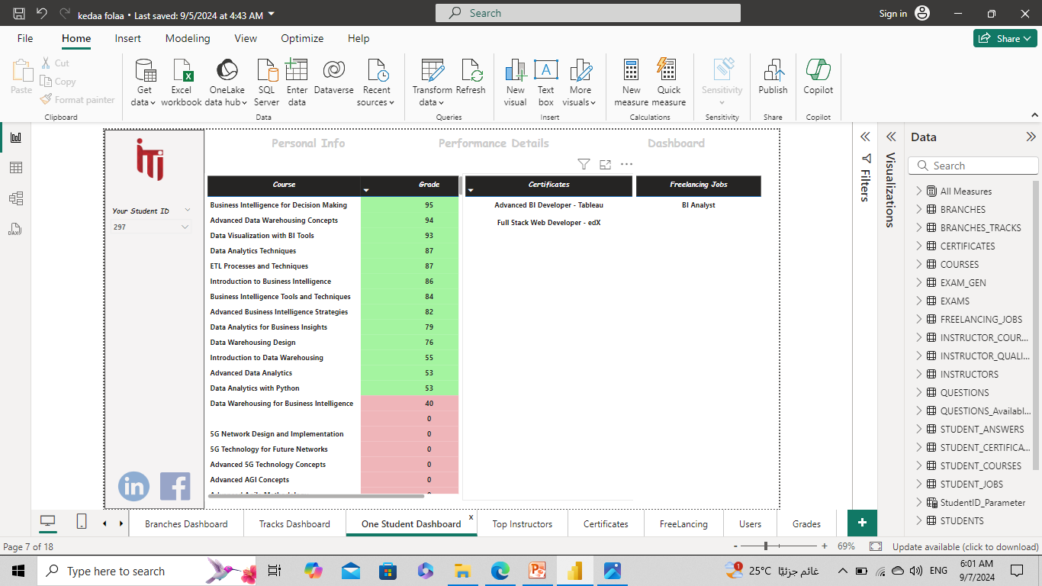
DASHBOARDS OVERVIEW
Student Dashboard (Performance Details)

